Slide 1
Personal
Portfolio
MARYAM MOHAMED
MACHINE LEARNING & DATA ANALYSIS ENGINEER

Slide 2
Table of Contents
OLIVIA WILSON
MACHINE LEARNING & DATA ANALYSIS ENGINEER
About
3
Work Experience
6
Project
9
Education
4
Services
7
Skills
5
My Process
8
GET IN TOUCH
10

Slide 3

About
MARYAM MOHAMED
MACHINE LEARNING & DATA ANALYSIS ENGINEER
I'm a Data Analyst & Machine Learning Engineer passionate about turning complex datasets into clear, actionable business insights.
From Raw Data to Smart Decisions.
I analyze data, uncover hidden insights, predict outcomes, and build machine learning solutions that turn information into real-world impact.
3

Slide 4

MARYAM MOHAMED
Education
MACHINE LEARNING & DATA ANALYSIS ENGINEER
Bachelor of Computer Science
Suez Canal University — Ismailia, Egypt
2024 – 2028 | Expected Graduation: 2028
Faculty of computers and informatics
Studying Programming, Data Structures, Databases, Data Analysis, Machine Learning, Artificial Intelligence, Mathematics, Statistics, and Web Development.
4

Slide 5
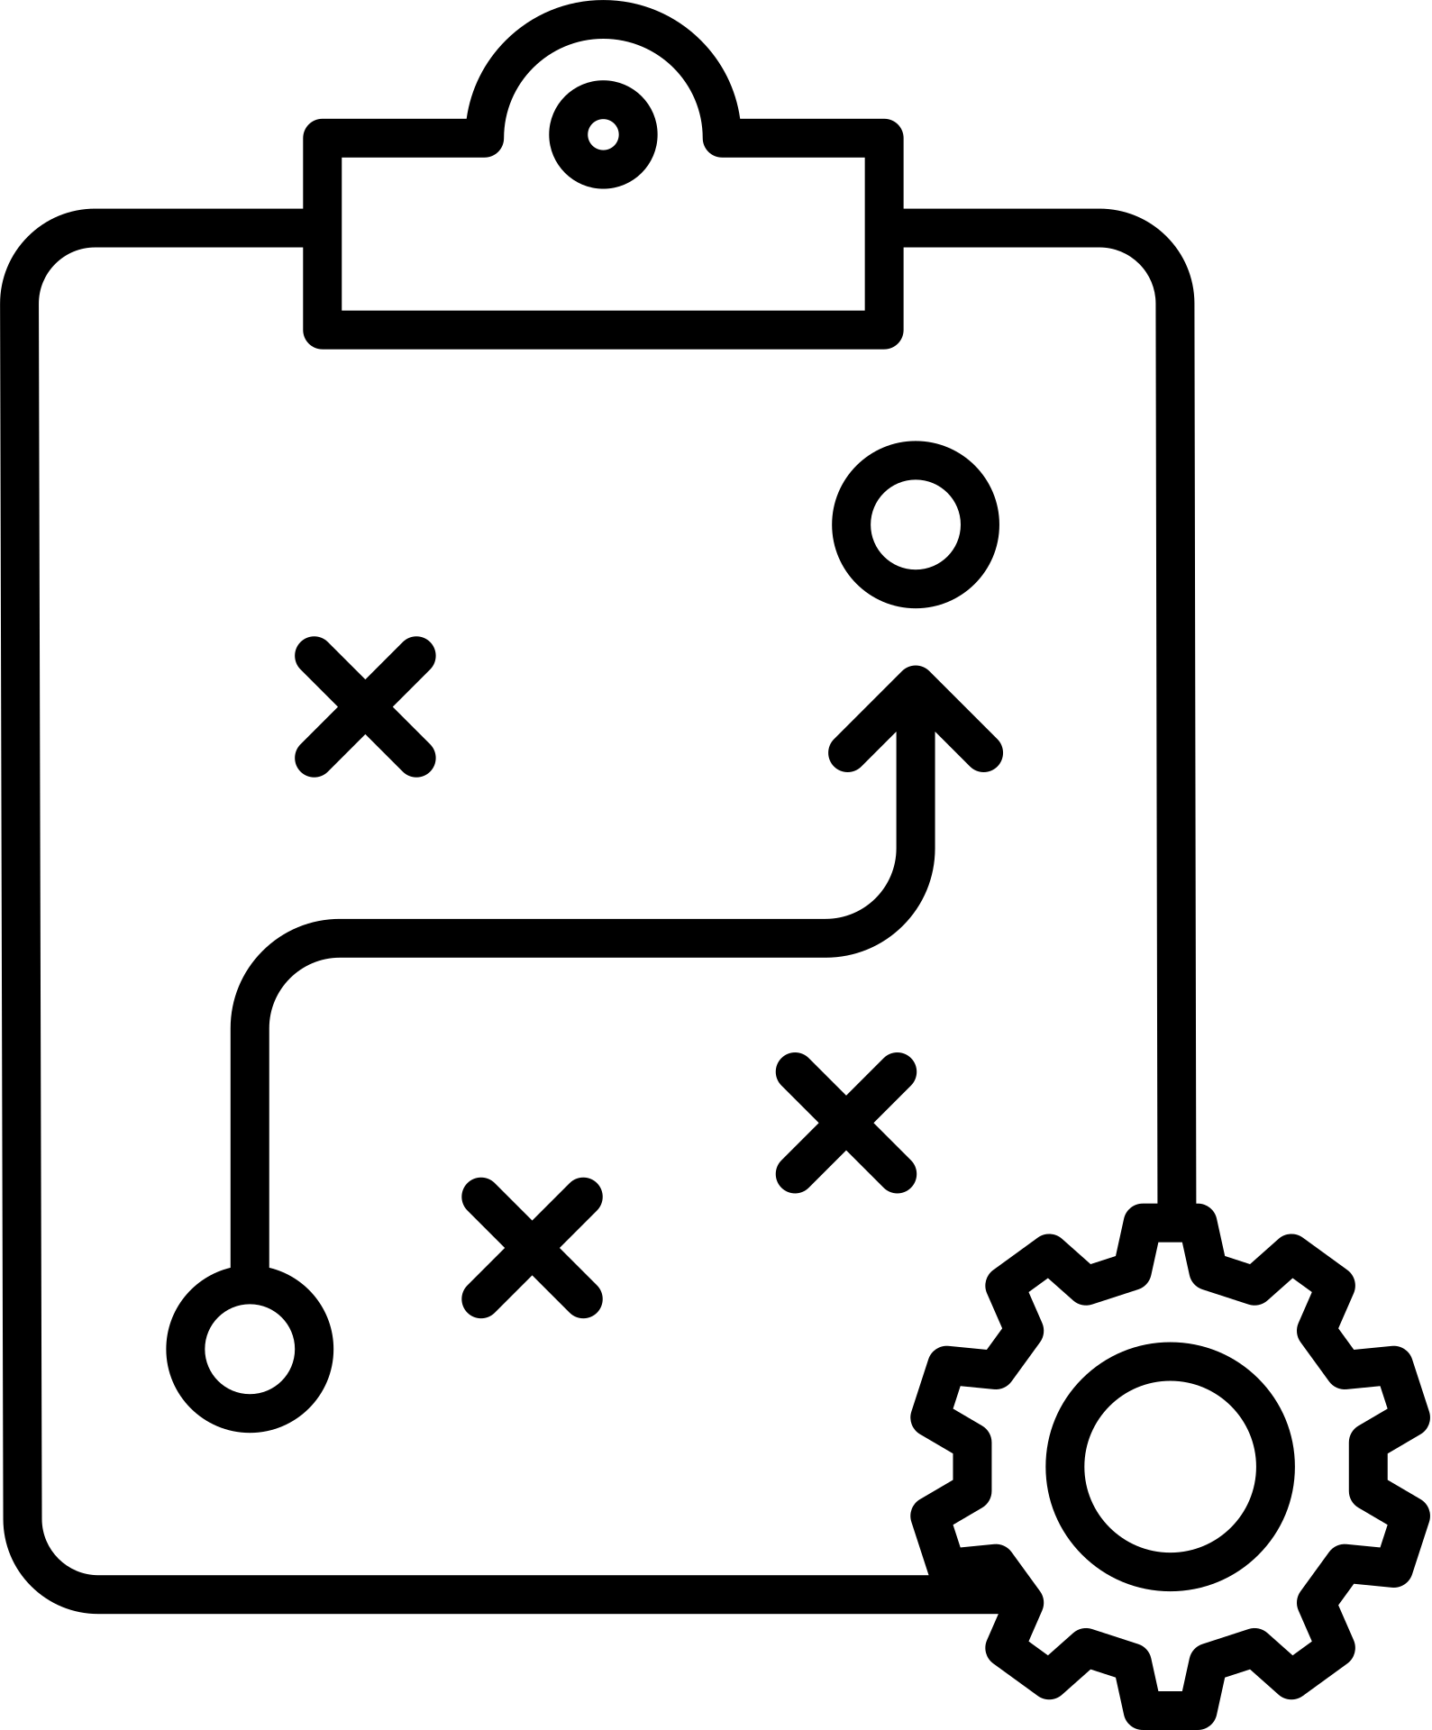


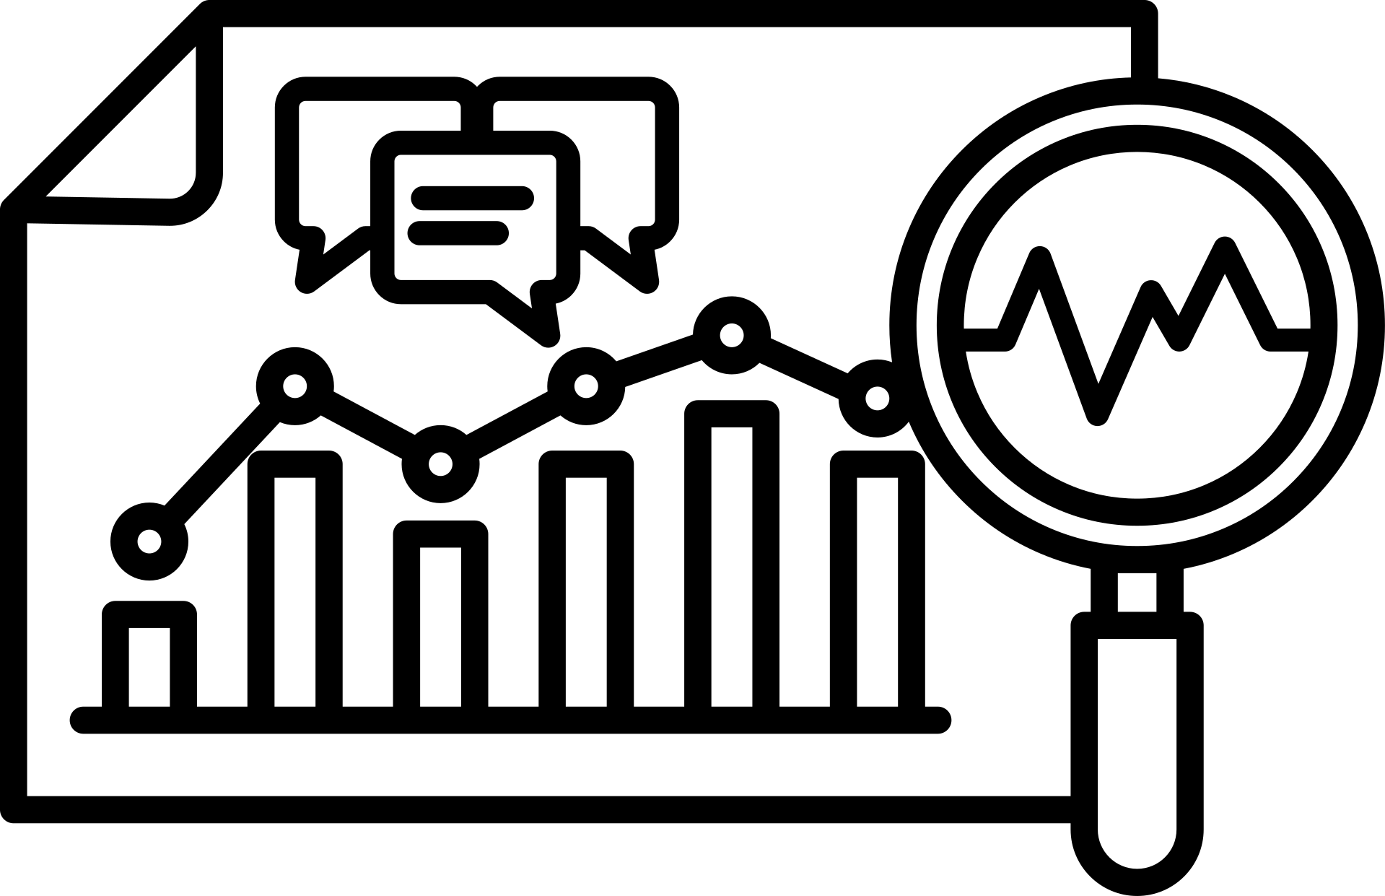
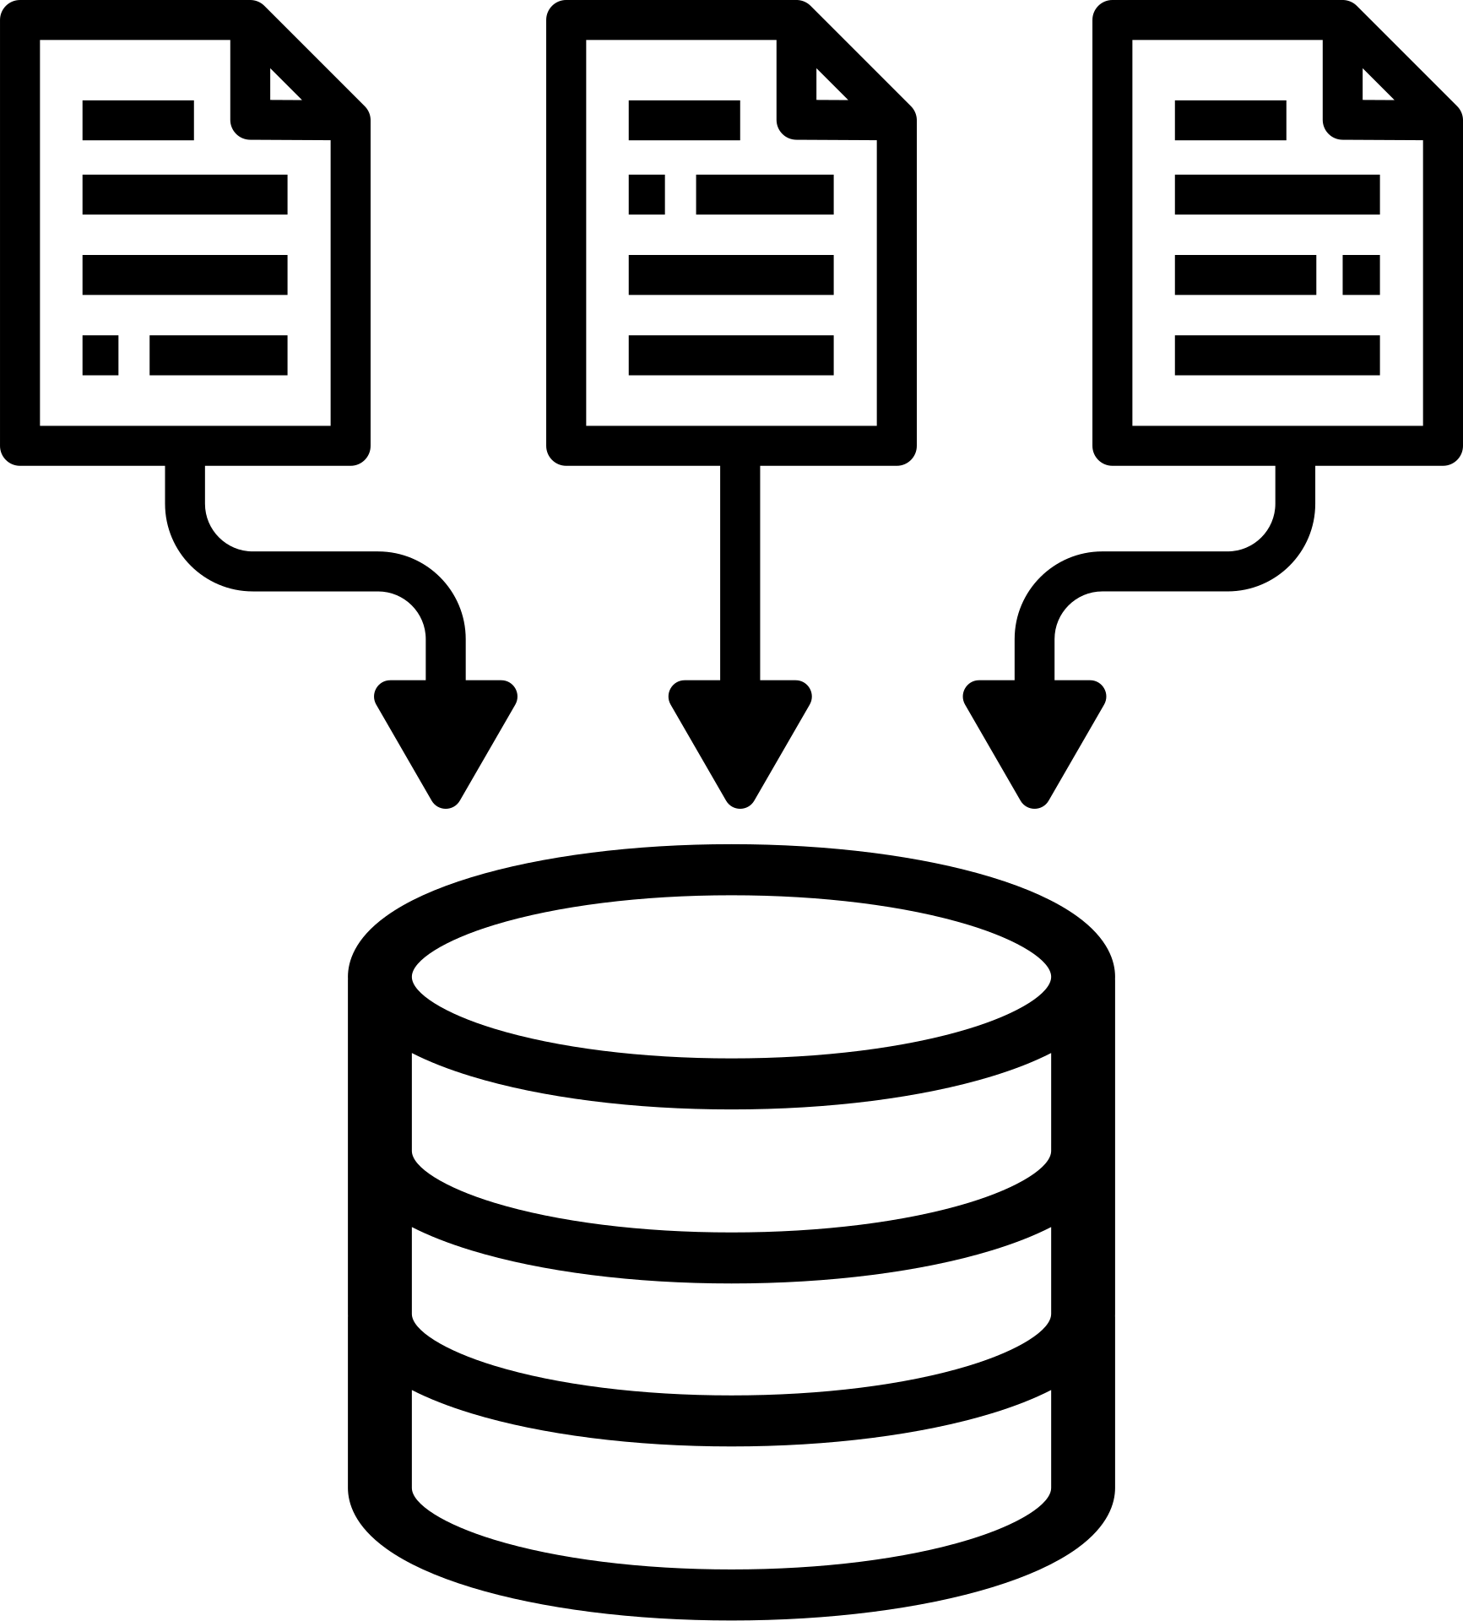
Skills
MARYAM MOHAMED
MACHINE LEARNING & DATA ANALYSIS ENGINEER
Data Analysis
Machine Learning
Visualization
Databases
Tools Used
Exploratory Data Analysis (EDA), Statistical Analysis, Data Cleaning & Preprocessing
Supervised & Unsupervised Learning, Feature Engineering, Model Evaluation
Interactive Dashboards, Data Storytelling, KPI Tracking, Reporting
SQL Query Optimization, Data Wrangling, Database Management, ETL Pipelines
Python, SQL, Power BI, Scikit-Learn, Pandas, NumPy, Git
5

Slide 6
MARYAM MOHAMED
Work Experience
MACHINE LEARNING & DATA ANALYSIS ENGINEER
Programming Instructor
PFK | 2026 – Present
Teaching Python programming concepts to students through practical, project-based learning.
Supporting learners with clear explanations and practical coding exercises.
Machine Learning Engineer Trainee
Digital Egypt Pioneers Initiative (DEPI) | 2026
Training in Machine Learning and Artificial Intelligence.
Studying Python, NumPy, Pandas, Data Preprocessing, Mathematics, Statistics, and Deep Learning.
Applying machine learning concepts through practical exercises and projects.
Data Analysis Trainee
NTI | 2026
Trained in Data Analysis using Excel, Python, and SQL.
Practiced data cleaning, analysis, transformation, and database fundamentals.
Developed practical skills for extracting insights from structured datasets.
6

Slide 7
Services
MARYAM MOHAMED
MACHINE LEARNING & DATA ANALYSIS ENGINEER
I build data-driven solutions and machine learning workflows that transform complex datasets into actionable insights. Through hands-on experience in exploratory data analysis, predictive modeling, and interactive visualization, I focus on solving real-world problems with clarity, efficiency, and statistical rigor.
Exploratory Data Analysis
Data Visualization & Dashboards
Machine Learning Modeling
Data Preprocessing
& Cleaning
Predictive Analytics
SQL & Database Querying
7

Slide 8
My Process
MARYAM MOHAMED
MACHINE LEARNING & DATA ANALYSIS ENGINEER
Data Collection
Modeling
Deployment
Problem definition, database querying & raw data gathering
Selecting algorithms, training ML models & hyperparameter tuning
Dashboard creation, model integration & insight reporting
1
2
3
4
5
Data Cleaning (EDA)
Evaluation
Handling missing values, exploratory analysis & feature engineering
Testing accuracy, cross-validation & metric assessment
8

Slide 9
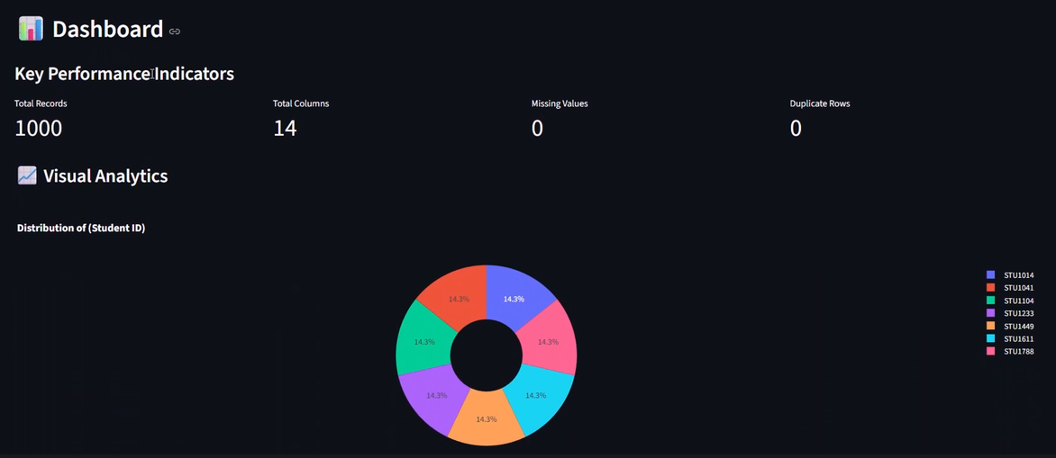
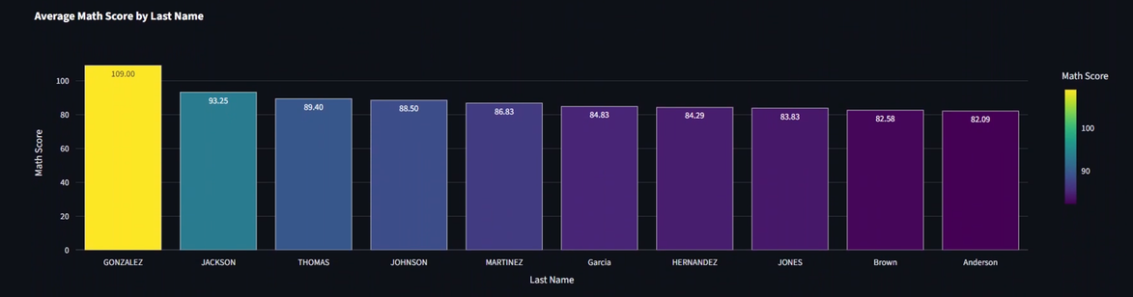

Project
MARYAM MOHAMED
MACHINE LEARNING & DATA ANALYSIS ENGINEER
InsightFlow – Smart Data Analysis Platform
Project Type
Data Analytics & Automation Platform
Outcome
Goal
Automated Cleaning & EDA
Smart missing-value imputation & data formatting
Build an interactive web app to automate data cleaning, EDA, visualization, and SQL storage.
Tech Stack / Tools
Interactive Dashboards
Dynamic Plotly
visualizations
for rapid insights
Python, Pandas, Streamlit, Plotly, SQL Server
9

Slide 10

GET IN TOUCH
MARYAM MOHAMED
MACHINE LEARNING & DATA ANALYSIS ENGINEER
Email
maryammoamed43@gmail.com
Phone
01278630966
LinkedIn
www.linkedin.com/in/maryam-mohamed1
10

Slide 11
Thank
You
MARYAM MOHAMED
MACHINE LEARNING & DATA ANALYSIS ENGINEER

